Slide 1

Retail Sales & Inventory Analytics
Mid-Project Progress Review: Weeks 1 & 2
Presented by Kunal Patle (Team Lead)
On behalf of the Data Analytics Intern Team – 5 - Kasak Siwal - Ahamad Irfan Maideen Y - Swetha Muthu

Slide 2

Phase 1: Foundation & Architecture
Establishing the robust backend data infrastructure, delegating ETL pipelines, and aligning the team framework.

Slide 3

Architecture & Governance – By Kunal Patle
Schema Design
Designed the overarching Relational Database schema in SQL Server, establishing strict primary/foreign key relationships across orders, customers, and payments tables.
Version Control
Established the team GitHub repository. Defined strict commit standards and branching strategies (`dev-data-cleaning`) to protect production stability.
Team Enablement
Consolidated setup scripts into unified 01_Schema_Setup.sql and updated READMEs to accelerate local deployment for the analytics team.

Slide 4

Data Ingestion (ETL) Execution
Under my architectural guidance, the team successfully executed the Week 1 Data Pipeline:
Ahamad Irfan Maideen Y : Configured the initial Python/Pandas & local SQL environments for preprocessing. Kasak siwal : Sourced the raw retail datasets and securely imported the data into the SQL database. Swetha muthu : Handled NULL values and engineered scripts to remove duplicate records, ensuring clean data ingestion.

Slide 5
Phase 2: Analytics & Dashboarding
Developing advanced SQL views, extracting core business metrics, and deploying the interactive Power BI dashboard.

Slide 6
Advanced SQL Metric Extraction
Revenue & Order KPIs – By Ahamad Irfan Maideen Y
Authored complex SQL queries aggregating the core financial metrics required for the dashboard views.
Successfully extracted precise calculations for Total Revenue and Average Order Value using advanced JOIN operations across the 100k+ row dataset.
Geographic & Product Trends - By Swetha Muthu
Engineered aggregations to identify strategic market trends based on the raw operational data.
Utilized GROUP BY and Window Functions to isolate Best-Selling Products by volume and map out Geographic sales distributions.

Slide 7
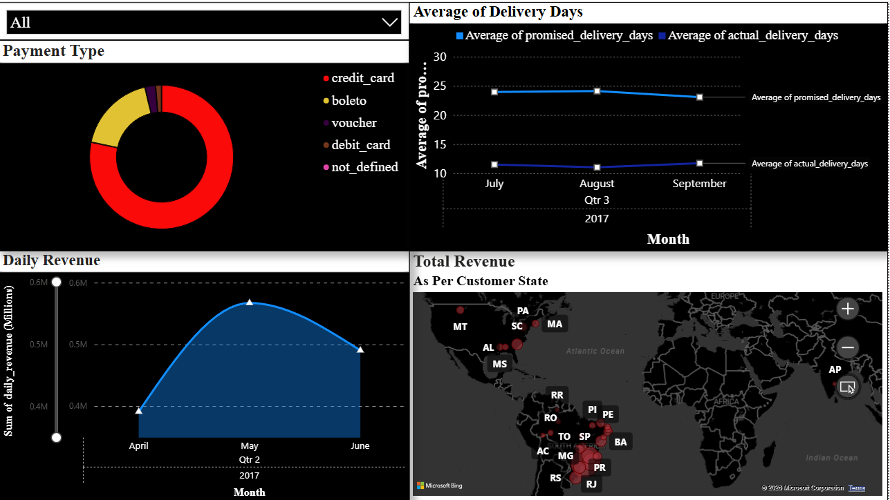
Power BI Dashboard Assembly
Dashboard Architecture – By Kunal Patle
Led the dashboard infrastructure setup by directly connecting the Power BI/Tableau platform to our live SQL Server views, eliminating manual flat-file dependencies.
Visual Components
Kasak: Built the 12-month Time-series Line charts to track revenue trends.
Ahmad: Developed comprehensive Bar charts detailing specific product performance.
Swetha: Implemented dynamic dashboard Slicers/Filters (City, Category) for interactivity.

Slide 8
Project Status
100%
Phase 1 & 2 Complete Ahead of Schedule
As a team, we have successfully surpassed the Week 1 and Week 2 milestones ahead of the proposed deadline. The backend SQL pipeline is consolidated, and the V1 Power BI deployment is active.
There are currently zero blockers moving into the frontend business strategy phase.

Slide 9
Roadmap Alignment & Task Accountability
Kunal (Lead)
Kasak (Analyst 1)
Ahmad (Analyst 2)
Swetha (Analyst 3)
Wk 1: Established GitHub repo & defined team commit standards.
Wk 2: Designed the foundational Relational Database schema in SQL.
Wk 3: Led architecture: connected Power BI/Tableau to SQL.
Wk 4: Extract key strategic findings (e.g., peak revenue days).
Wk 1: Sourced the raw retail dataset (order_id, price, etc.).
Wk 2: Executed the secure import of cleaned data into SQL.
Wk 3: Built foundational 12-month time-series line charts.
Wk 4: Draft Q4 promotion recommendations.
Wk 1: Set up Python/Pandas & local SQL environment.
Wk 2: Authored queries for Total Revenue & Avg Order Value.
Wk 3: Developed Bar charts detailing product performance.
Wk 4: Finalize README.md with screenshots.
Wk 1: Handled NULL values & removed duplicates.
Wk 2: Aggregated Best-Selling Products & Geographic trends.
Wk 3: Implemented Slicers/Filters (City, Category).
Wk 4: Audit all 4 weeks of GitHub commits.

Slide 10
Questions?

Slide 11

THANK YOU!
Kunal | Team Lead Data Analytics Intern Team No. 05 - Infotact Solutions
Phone
+91 9156414056
Email
kunalpatle2000@gmail.com

